Slide 1
Object Detection Models
Contents
One-Stage, Anchor-Based Detectors
YOLO Family
EfficientDet Series
SSD & Variants
RetinaNet
2. Two-Stage Detectors
Faster R-CNN
Mask R-CNN
Cascade R-CNN
3. Transformer-Based Detectors (DETR Variants)
DETR
DINO
Grounding DINO
4. Vision–Language (Multi-Modal) Models
CLIP

Slide 2
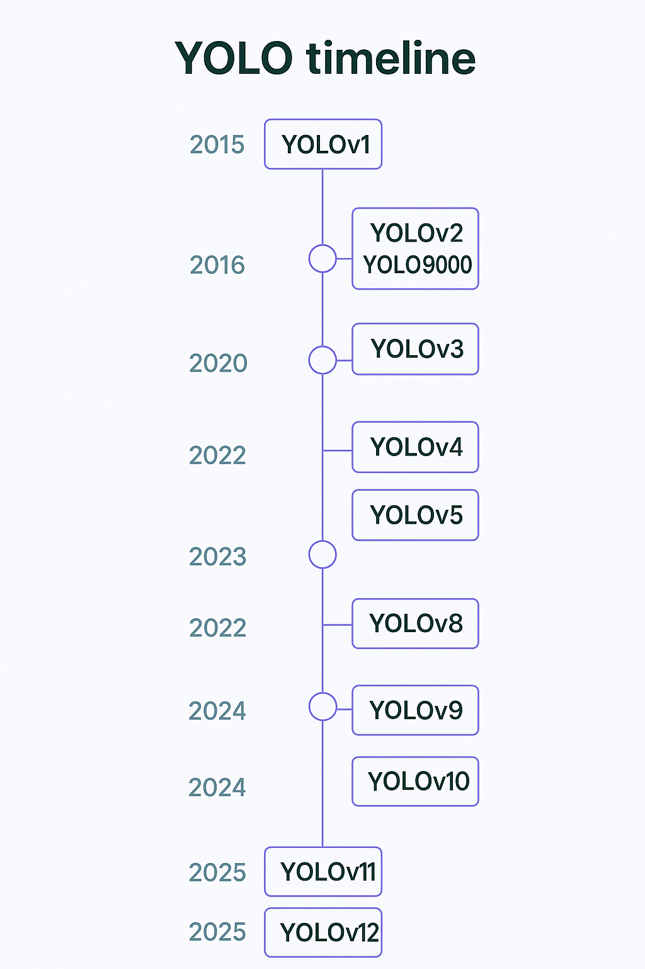
YOLO Family
What Is YOLO
“You Only Look Once” (YOLO) proposes using an end-to-end neural network that makes predictions of bounding boxes and class probabilities all at once, rather than repurposing classifiers for detection.
Single Iteration, End-to-End
YOLO performs all its predictions with a single fully connected layer, requiring just one forward pass over the image to produce detections.
Fast Inference for Real-Time
By unifying the entire detection pipeline into one network, YOLO processes an image in a single pass, enabling real-time speeds
Global Reasoning
By seeing the full image during both training and inference, YOLO encodes contextual information—reducing background false positives compared to sliding-window or proposal-based methods.

Slide 3
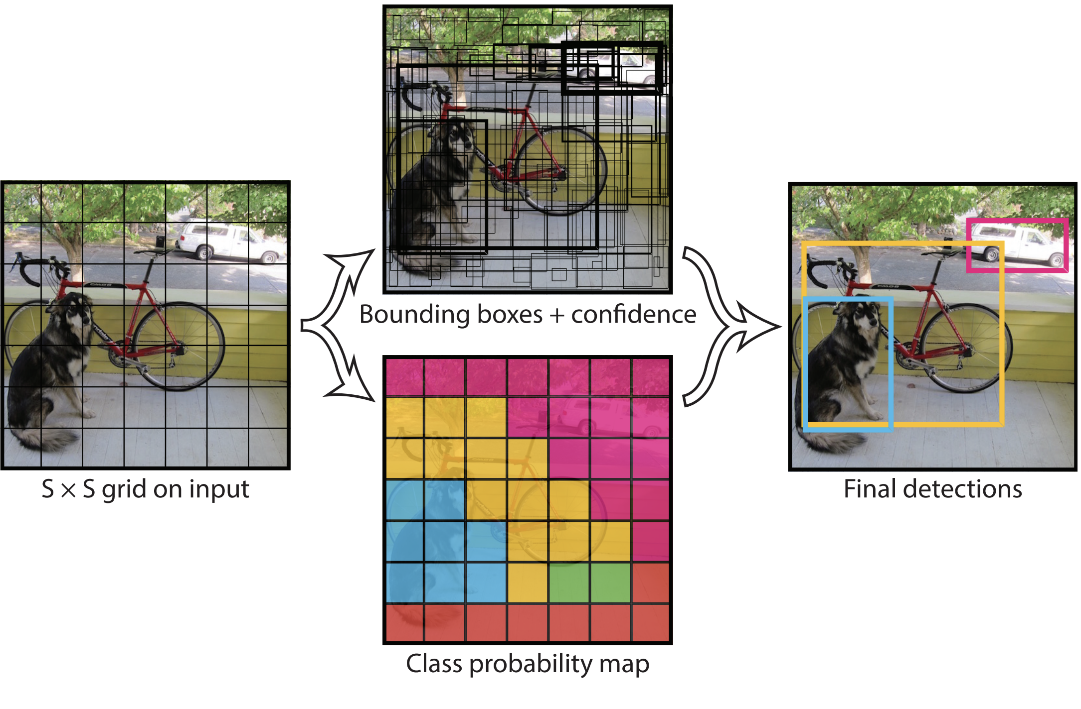
YOLO Working
How does YOLO work ?
The YOLO algorithm works by dividing the image into N grids, each having an equal dimensional region of SxS.
Each of these N grids is responsible for the detection and localization of the object it contains.
Correspondingly, these grids predicts B bounding box coordinates relatives to their cell coordinates, along with the object label and probability of the object being present in the cell.

Slide 4
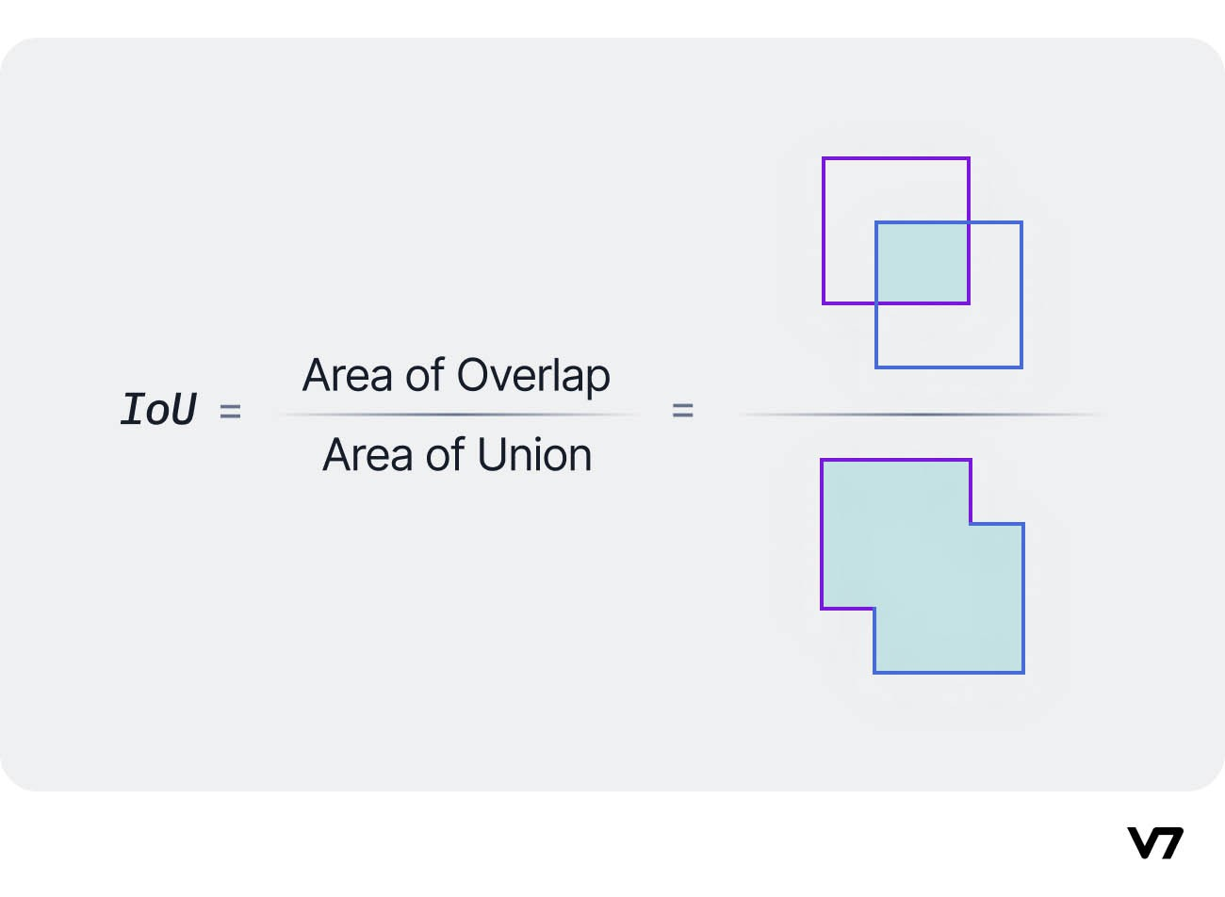
Object detection models performance evaluation metrics
Intersection of Union
Intersection over Union is a popular metric to measure localization accuracy an
To calculate the IoU between the predicted and the ground truth bounding boxes, we first take the intersecting area between the two corresponding bounding boxes for the same object. Following this, we calculate the total area covered by the two bounding boxes— also known as the “Union” and the area of overlap between them called the “Intersection.”
The intersection divided by the Union gives us the ratio of the overlap to the total area, providing a good estimate of how close the prediction bounding box is to the original bounding box.

Slide 5
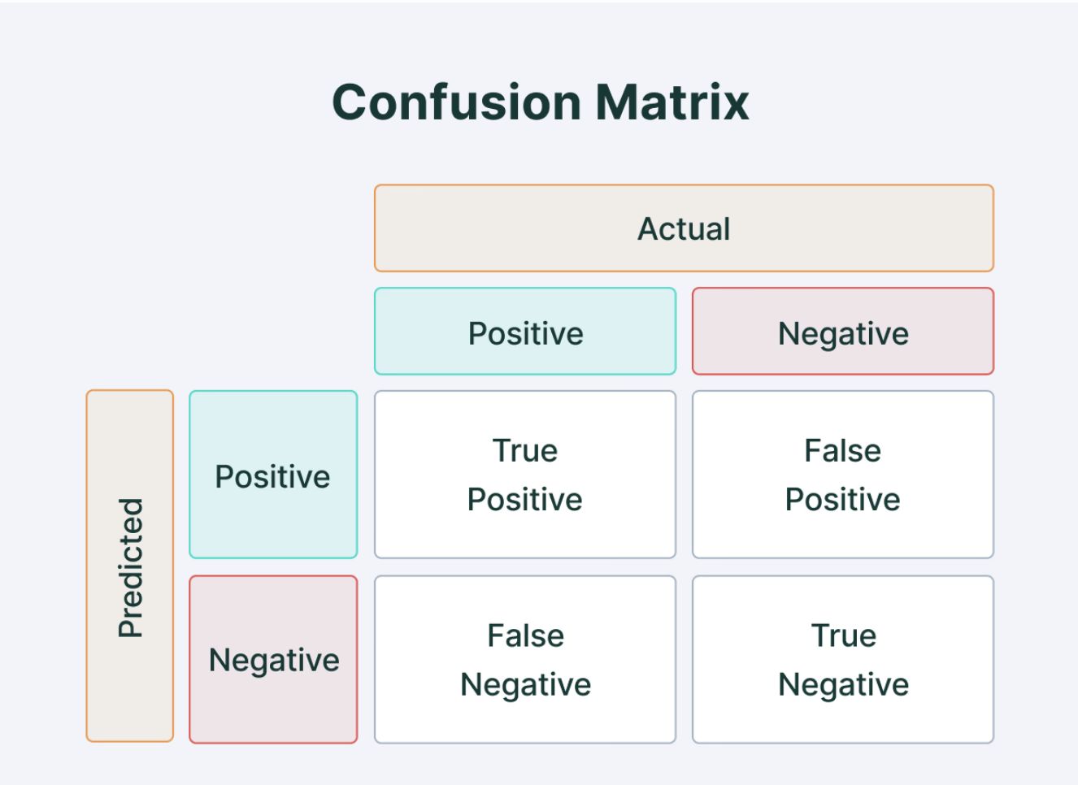
Average Precision
Average Precision (AP) is calculated as the area under a precision vs. recall curve for a set of predictions.
Recall is calculated as the ratio of the total predictions made by the model under a class with a total of existing labels for the class. Precision refers to the ratio of true positives with respect to the total predictions made by the model.
Recall and precision offer a trade-off that is graphically represented into a curve by varying the classification threshold. The area under this precision vs. recall curve gives us the Average Precision per class for the model. The average of this value, taken over all classes, is called mean Average Precision (mAP).

Slide 6
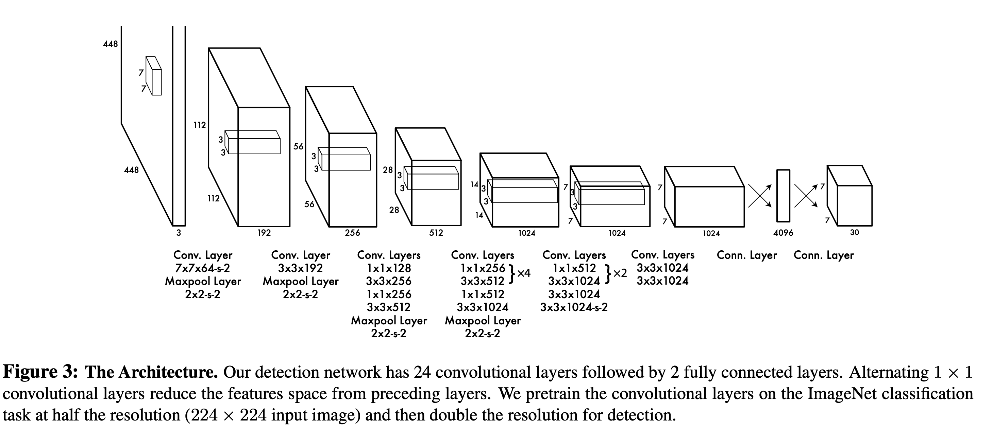
YOLO Architecture
Key Features of YOLOv1 Architecture
Single-pass detection: The whole image is processed in one forward pass.
1×1 Convolutions: Reduce computation and add non-linearity (a technique from GoogLeNet).
Unified detection: Predicts class probabilities and bounding boxes together.
Pretraining: The conv layers are pretrained on ImageNet at 224×224, then fine-tuned on 448×448 for detection.
Stage | Size | What Happens
Input | 448×448×3 | Image input
Initial Conv | 7×7, stride 2 | Broad feature extraction
Pooling | 2×2, stride 2 | Downsampling
Conv Blocks | 1×1, 3×3, maxpool | Repeated for depth and spatial size
Deep Conv | 7×7×1024 | Complex, high-level features
Fully Connected | 4096 | Dense representation
Output | 7×7×30 | Grid of bounding boxes + classes

Slide 7
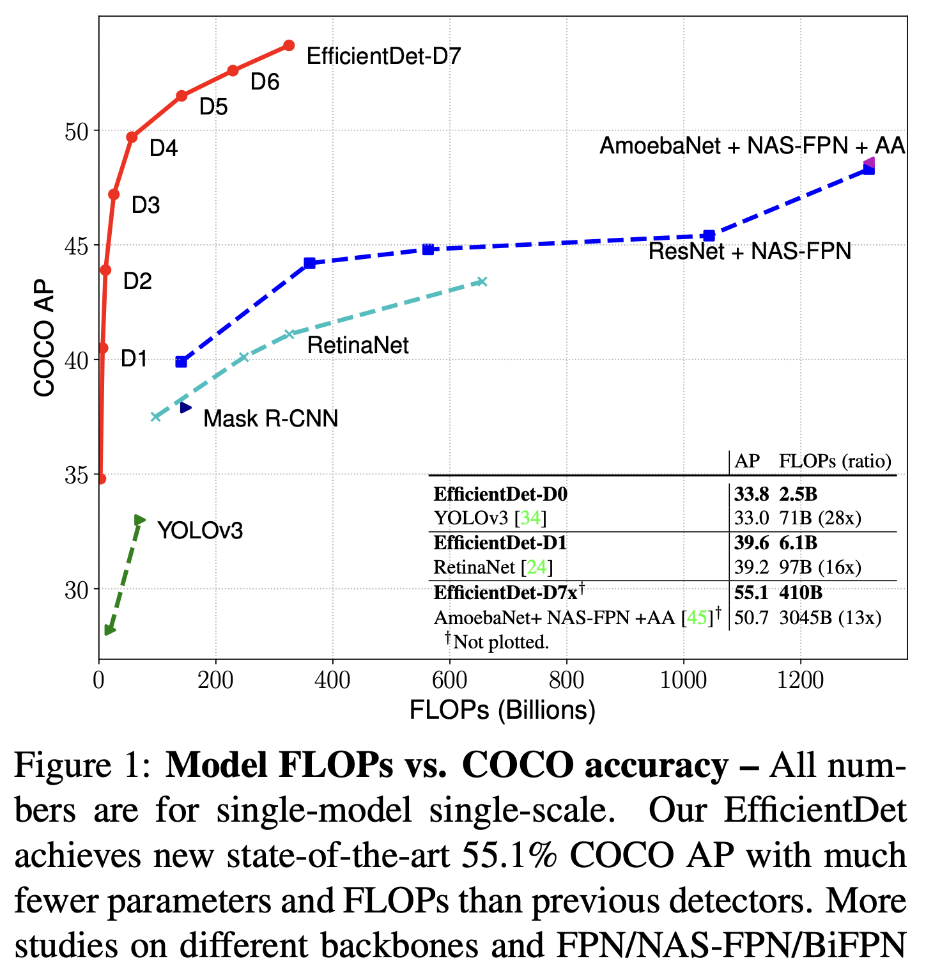
EfficientDet
EfficientDet is a family of object detection models designed for both speed and accuracy, making it suitable for real-world applications on everything from mobile devices to cloud servers. By rethinking how detectors handle multi-scale features and how models are scaled up, EfficientDet delivers state-of-the-art accuracy using far fewer parameters and FLOPs than previous object detectors.
Key Points:
Achieves strong detection results with much smaller model size and computation.
Introduces optimizations that address the limitations of large, slow detectors like NAS-FPN and RetinaNet.
Enables efficient deployment in resource-constrained environments.

Slide 8
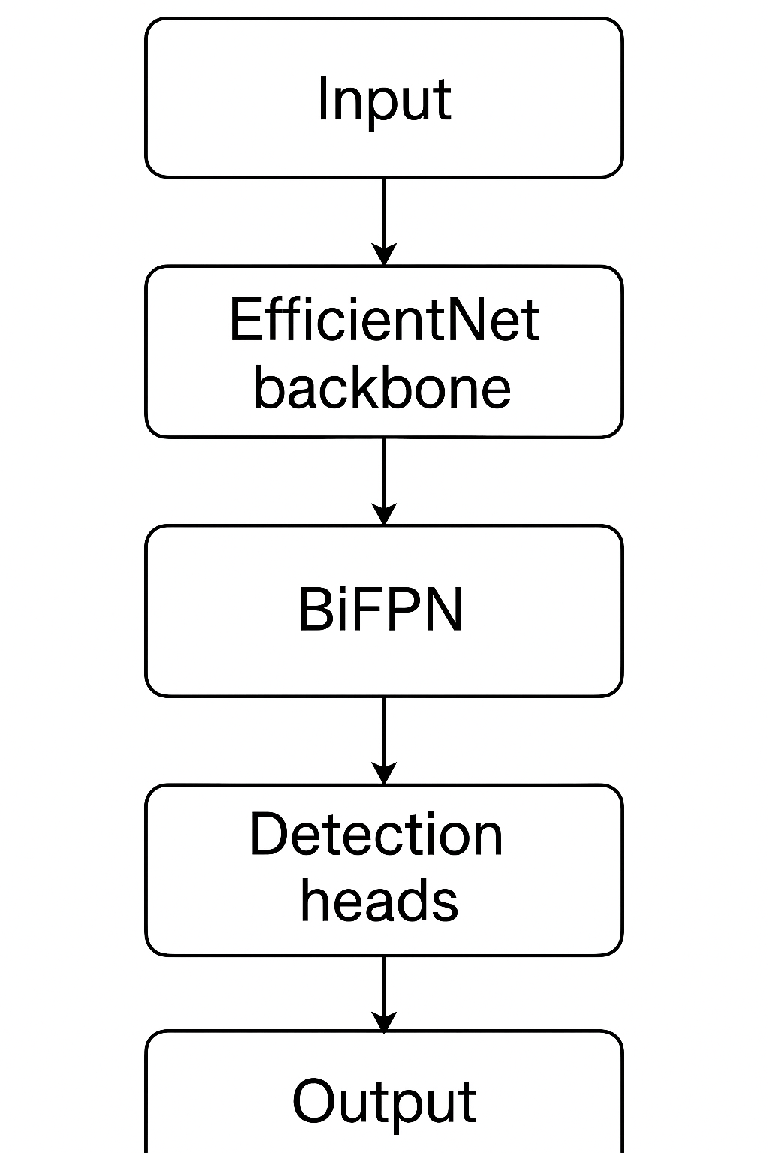
EfficientDet- Workflow
EfficientDet follows a one-stage detection paradigm, meaning it predicts object classes and bounding boxes in a single forward pass through the network.
How EfficientDet Works:
Uses EfficientNet as the backbone to extract rich feature maps from the input image with minimal computation.
Features from multiple scales are fused together using a Bi-directional Feature Pyramid Network (BiFPN), which combines information from different resolutions more effectively through learnable weights.
Employs compound scaling to jointly scale the model’s resolution, depth, and width, enabling the creation of small, fast models or larger, more accurate ones as needed.
The final detection heads simultaneously output bounding box coordinates and class probabilities for every relevant region.

Slide 9
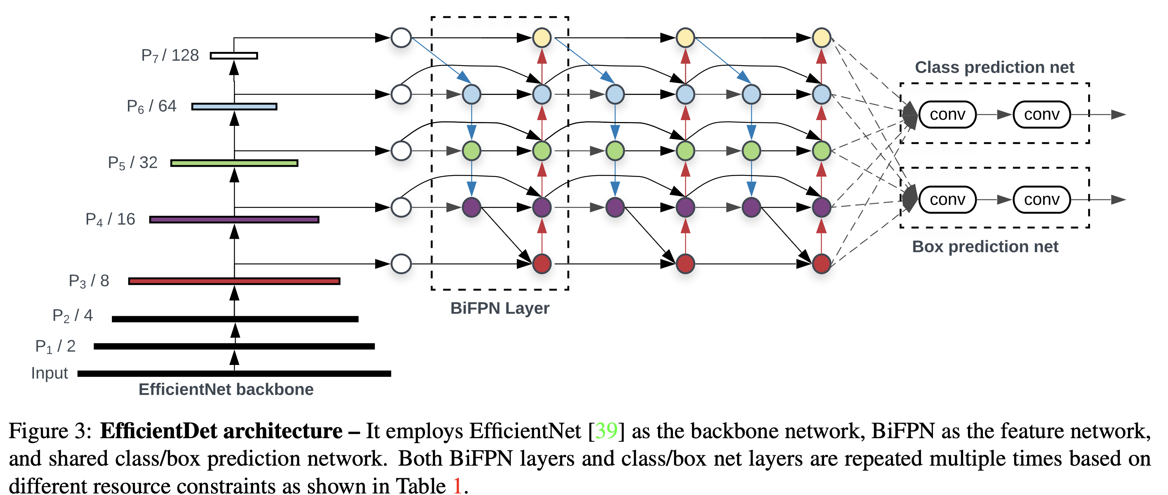
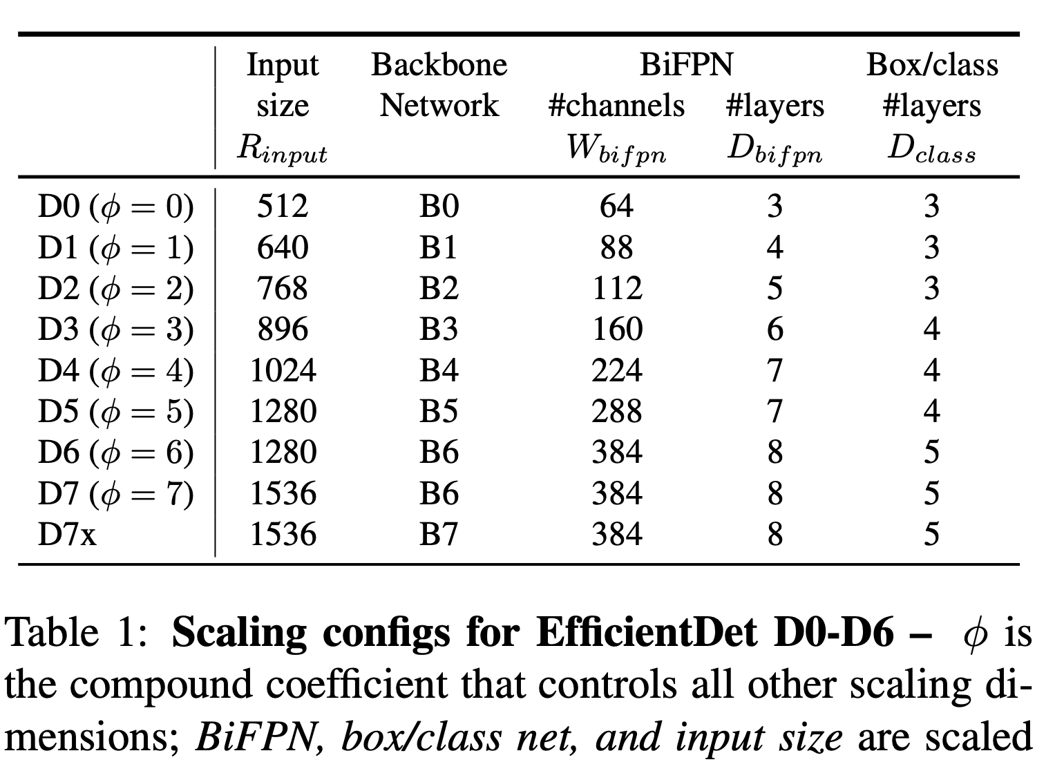
EfficientDet Architecture
The architecture of EfficientDet is streamlined for efficiency and scalability, while still supporting complex detection tasks.
Input: The image is fed into the EfficientNet backbone for feature extraction.
Multi-scale Features: Feature maps from different levels (P3–P7) are combined using the BiFPN, which allows for repeated top-down and bottom-up fusion and assigns importance to each feature using learnable weights.
Prediction Heads: Shared class and box heads make predictions from each fused feature map, producing final bounding boxes and class labels.
Compound Scaling: The entire pipeline is scalable, so you can choose the right EfficientDet model size for your hardware and accuracy needs.

Slide 10
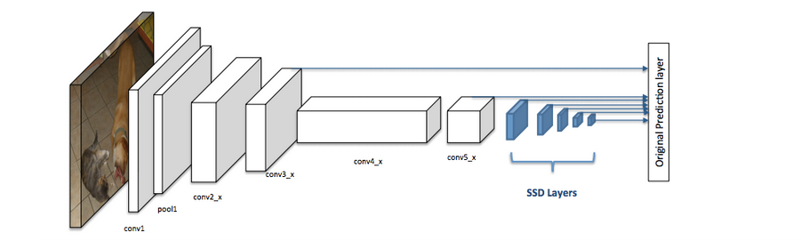
Single Shot MultiBox Detector (SSD)
SSD is a deep learning object detection model that streamlines the detection pipeline by eliminating the need for separate region proposal and feature resampling stages.
It predicts bounding boxes and class scores directly from images in a single forward pass, making it both accurate and extremely fast, suitable for real-time applications.
Key points:
Directly predicts categories and bounding box offsets from multiple feature maps.
Efficiently handles objects at different scales and aspect ratios.
Outperforms earlier real-time detectors like YOLO in both speed and accuracy.

Slide 11
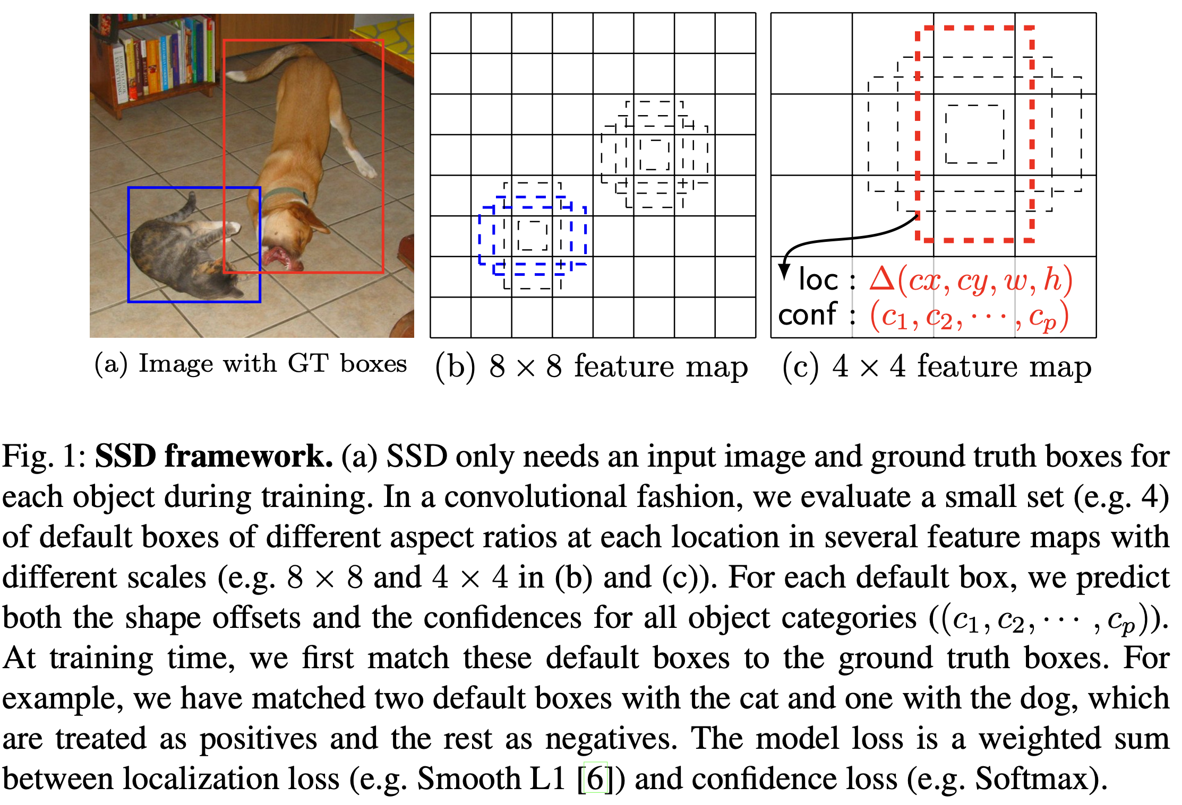
SSD Workflow
The SSD workflow revolves around discretizing the output space of bounding boxes into a set of default boxes at various aspect ratios and scales for each feature map location.
The input image is processed by a base CNN (typically VGG-16, truncated before classification).
Multiple additional convolutional layers generate feature maps at decreasing spatial sizes.
At each location in these maps, a fixed set of default bounding boxes (of different shapes) is considered.
For each default box, the network predicts:
Bounding box offsets (location refinement).
Confidence scores for each object category.
Non-maximum suppression (NMS) is applied to produce the final set of detections.

Slide 12
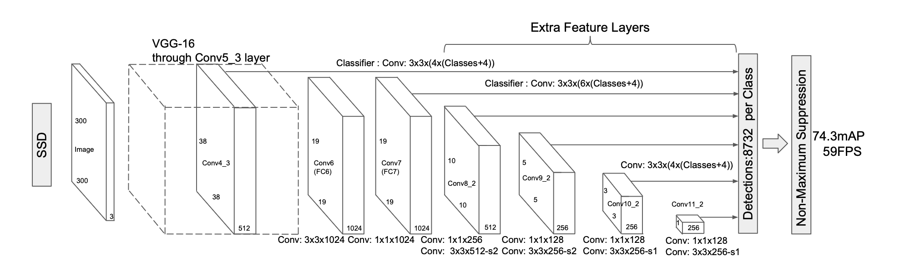
SSD Architecture
SSD’s architecture is built on a feed-forward convolutional network augmented by additional layers for multi-scale detection
Base Network: Truncated VGG-16 is commonly used for initial feature extraction.
Extra Feature Layers: Additional convolutional layers produce lower-resolution feature maps for detecting larger objects.
Multi-scale Detection: Predictions are made from multiple layers (conv4_3, conv7, conv8_2, etc.), each responsible for objects at different sizes.
Convolutional Predictors: Small 3×3 convolutional filters applied to each feature map location for predicting class scores and bounding box offsets.
Default Boxes: Each feature map cell uses multiple default boxes with various aspect ratios and scales.

Slide 13
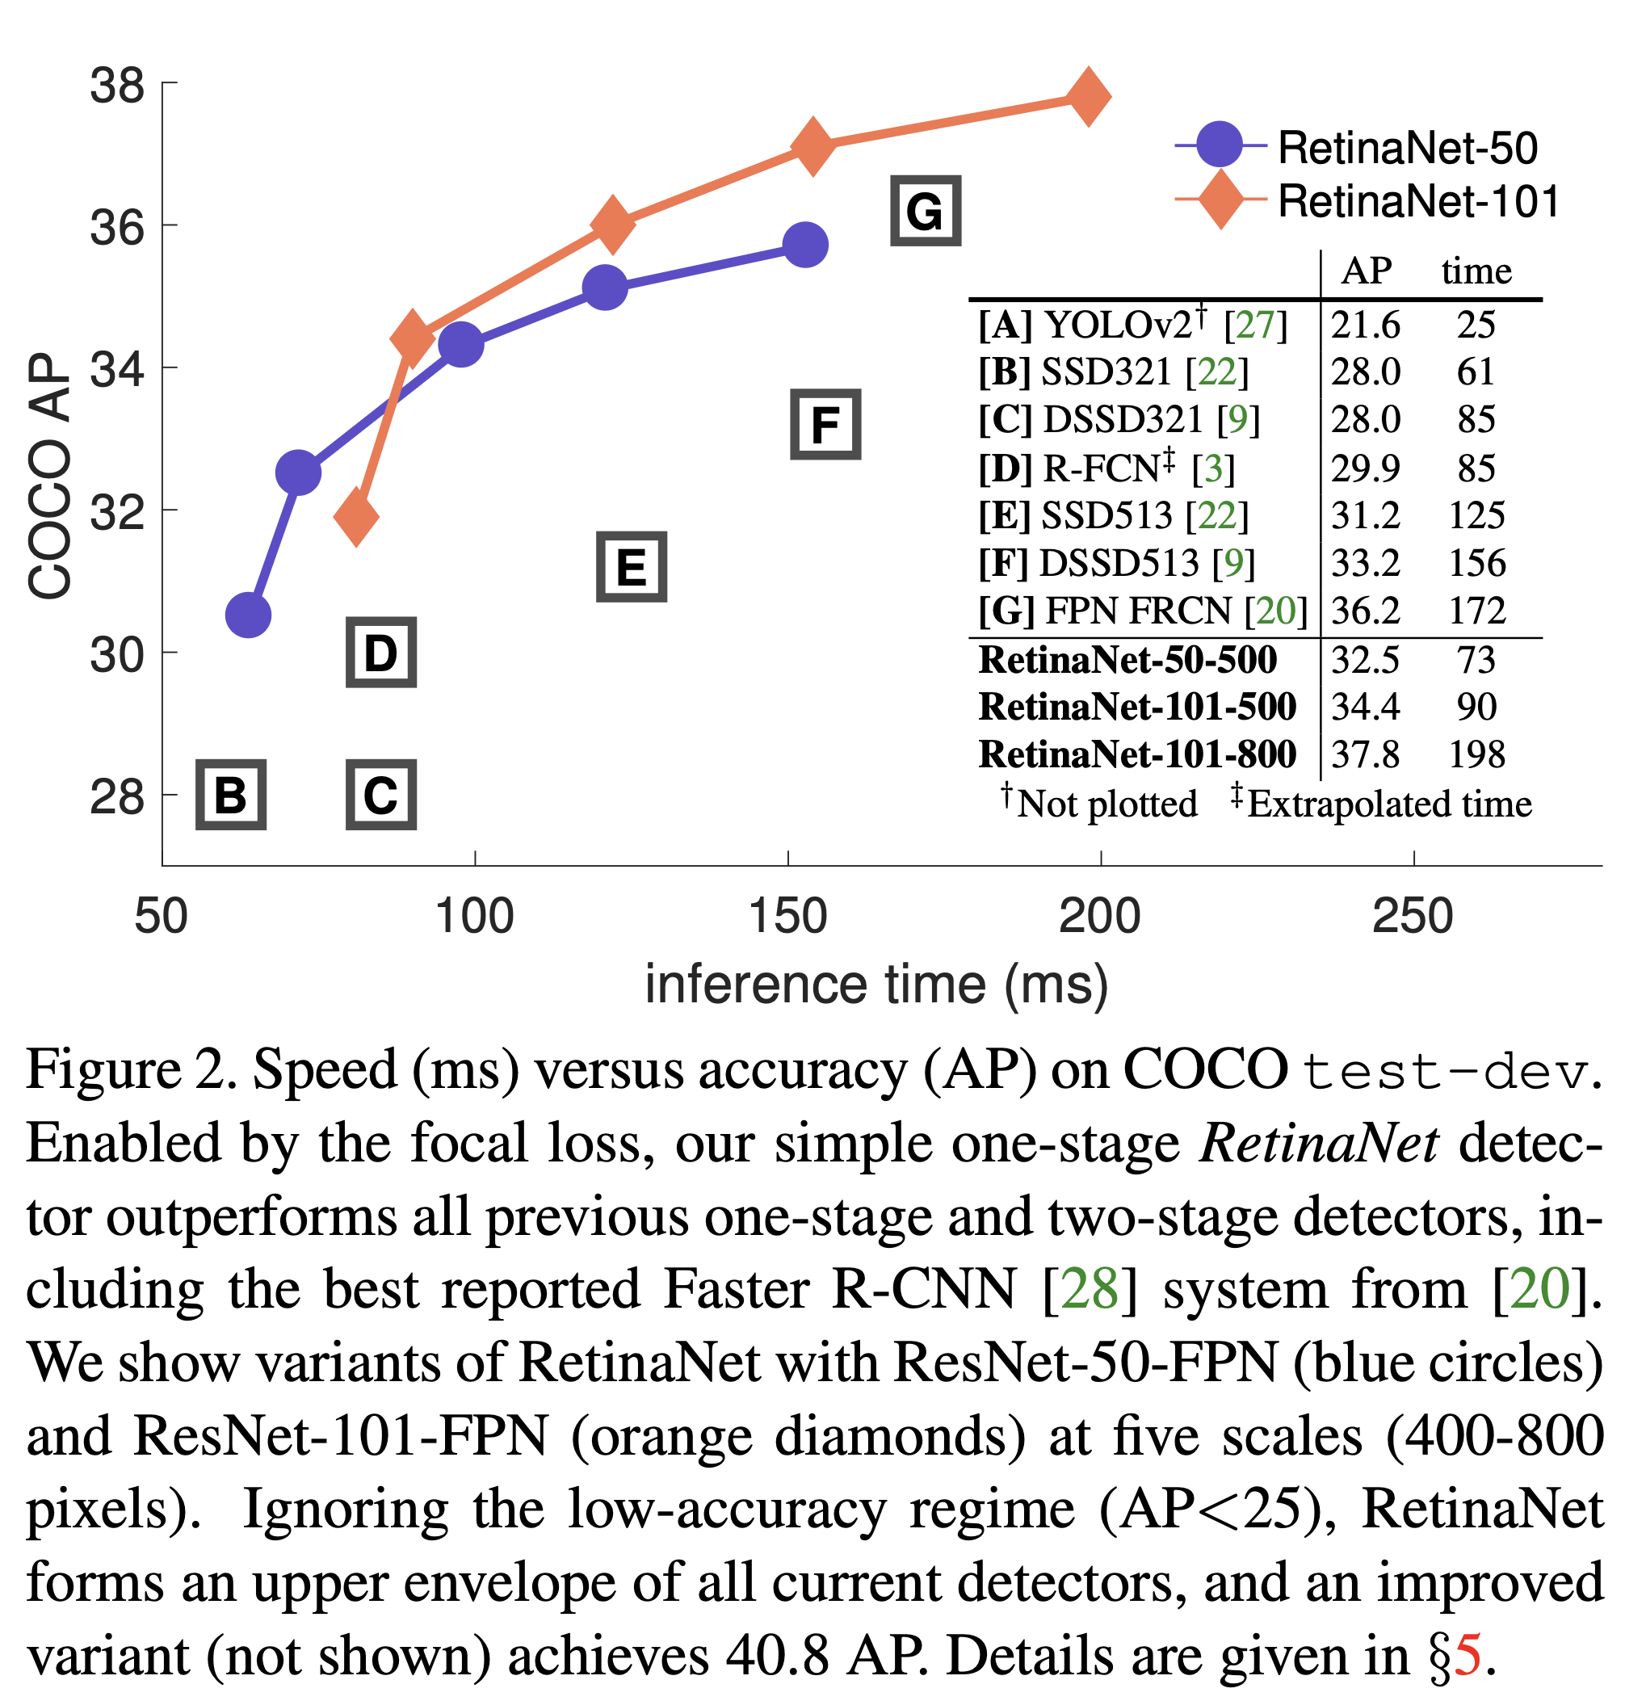
RetinaNet
RetinaNet is a one-stage object detector that achieves both high accuracy and fast inference by addressing the extreme foreground-background class imbalance in dense detection. It introduces the Focal Loss to focus learning on hard, misclassified examples, enabling one-stage detectors to rival or surpass two-stage detectors like Faster R-CNN in accuracy.
Key points:
Closes the accuracy gap between one-stage (fast) and two-stage (accurate) detectors.
Well-suited for real-time applications due to simple and efficient design.

Slide 14
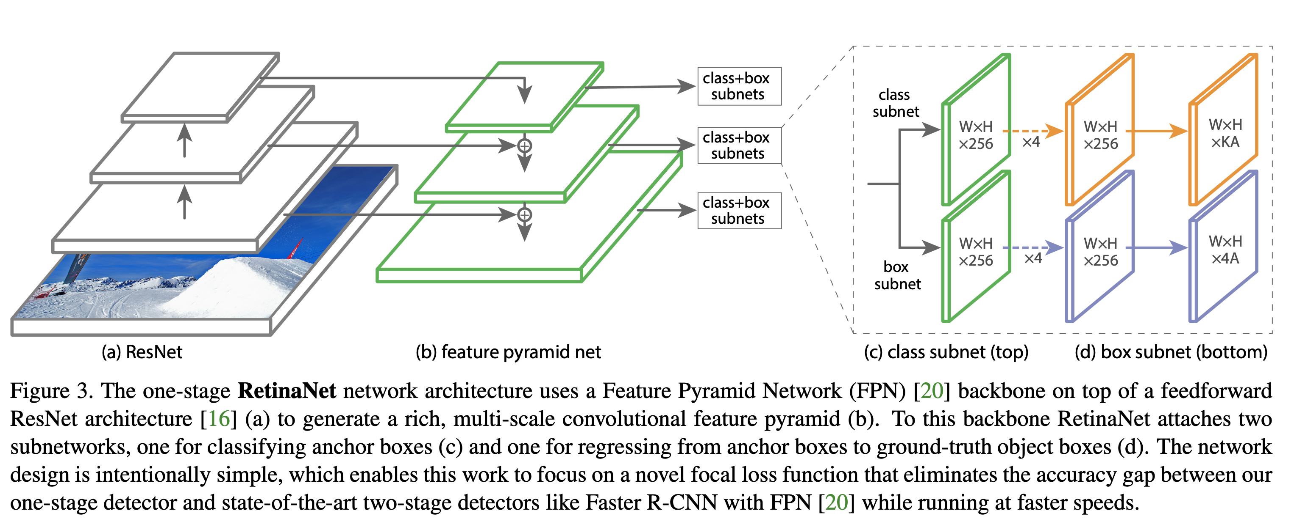
RetinaNet Workflow
RetinaNet processes images in a single shot, predicting classes and bounding boxes for a dense grid of anchors across multiple feature map levels.
Workflow steps:
Input image passes through a ResNet+FPN backbone, generating a pyramid of multi-scale feature maps.
At each location on every feature map, multiple anchor boxes are generated with different scales and aspect ratios.
Two subnetworks process each anchor:
Classification subnet: predicts probability of each class for each anchor.
Box regression subnet: predicts bounding box coordinates for each anchor.
All predictions are post-processed with non-maximum suppression to remove duplicates.

Slide 15
RetinaNet Architecture
RetinaNet is built around three main components:
ResNet + Feature Pyramid Network (FPN) backbone: Extracts rich, multi-scale features from the image.
Classification subnet: Deep, small fully-convolutional network that outputs class probabilities for every anchor at every spatial position.
Box regression subnet: Predicts box offsets for each anchor.
Uses anchor boxes of multiple scales and aspect ratios at each feature map location.

Slide 16
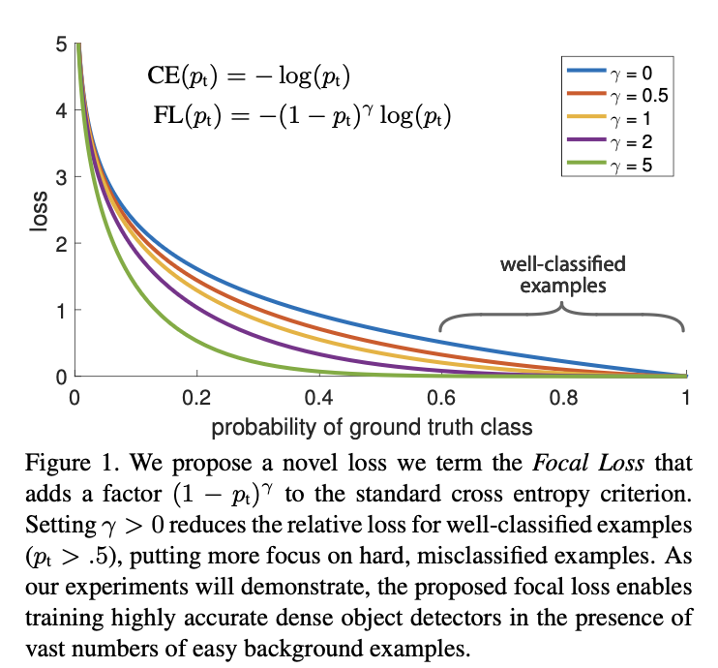
RetinaNet: Focal Loss
FL(pt) =−(1−pt)γlog(pt)
Every sample is weighted according to its error!
Modulating factor added
Focusing parameter γ smoothly adjusts the rate at which easy examples are downweighted
Misclassified, pt is small, modulating factor is near 1, loss is unaffected.
As pt → 1, the factor goes to 0 and the loss for well-classified examples is down-weighted..
with γ = 2, example classified with pt = 0.9 would have 100× lower loss compared to CE and with pt ≈ 0.968 it would have 1000× lower loss. This in turn increases the importance of correcting misclassified examples!

Slide 17
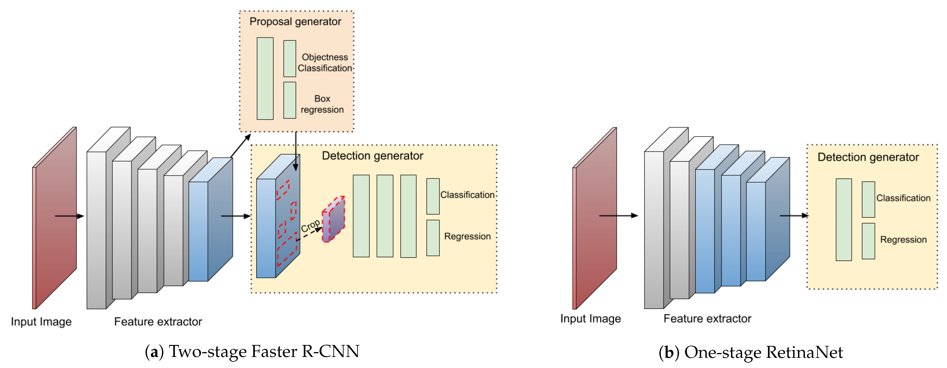
Two-Stage Object Detectors
Two-stage detectors break the object detection process into two distinct steps:
Region Proposal:
The first stage generates a set of candidate object regions (region proposals) within the image, which are likely to contain objects.
Traditional methods (like Selective Search) use hand-crafted features and are computationally expensive, while modern two-stage detectors (like Faster R-CNN) use neural networks (Region Proposal Networks, RPNs) to generate these proposals efficiently
2.Region Classification and Refinement:
The second stage classifies each proposed region and refines its bounding box.
A convolutional neural network extracts features from each proposal and predicts the object class and bounding box adjustments.

Slide 18
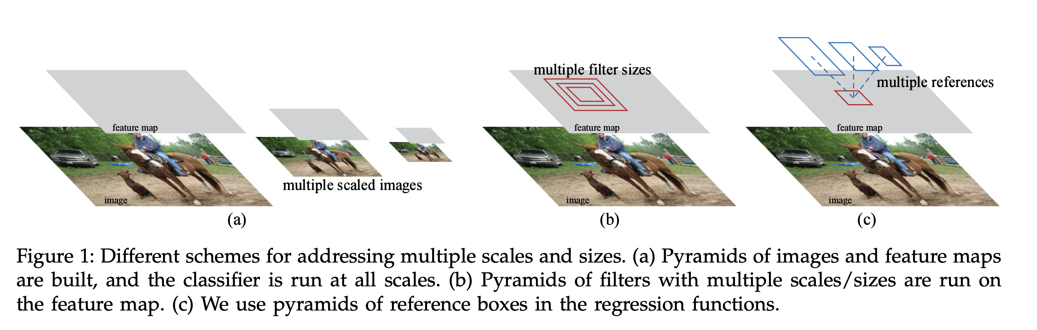
Faster R-CNN
Faster R-CNN is a two-stage object detection framework that integrates deep learning for both generating region proposals and performing object classification and bounding box regression. It builds upon previous R-CNN models by introducing a Region Proposal Network (RPN), making the process much faster and more accurate.
Combines region proposal and detection in a single, unified network.
Achieves state-of-the-art accuracy with improved speed compared to earlier detectors.

Slide 19
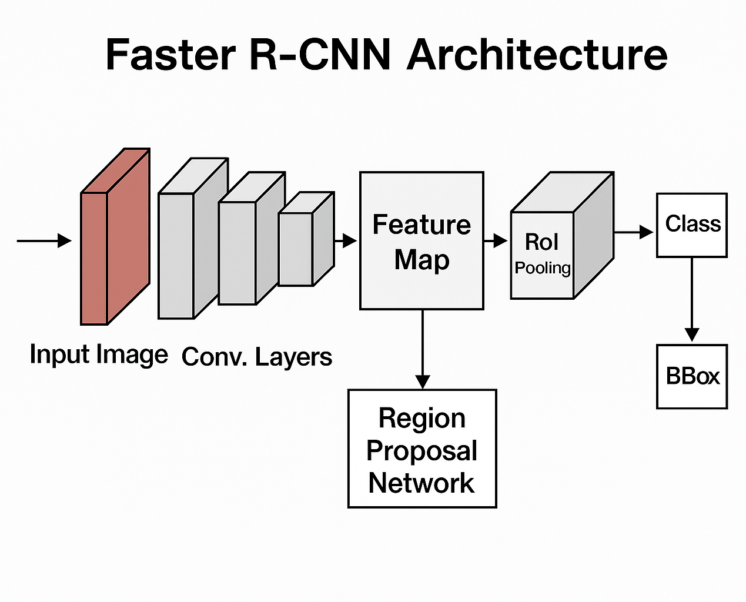
Faster R-CNN - workflow
Faster R-CNN breaks the object detection process into two stages:
Region Proposal:
Uses a Region Proposal Network (RPN) to scan the feature map and generate candidate object regions (proposals) likely to contain objects.
Proposals are generated efficiently via sliding windows and anchor boxes at each position.
2.Region Classification & Refinement:
For each proposal, ROI pooling extracts a fixed-size feature map.
The network classifies the region (object category or background) and refines the bounding box coordinates.
The RPN and the detection network share convolutional features, making the system efficient.

Slide 20
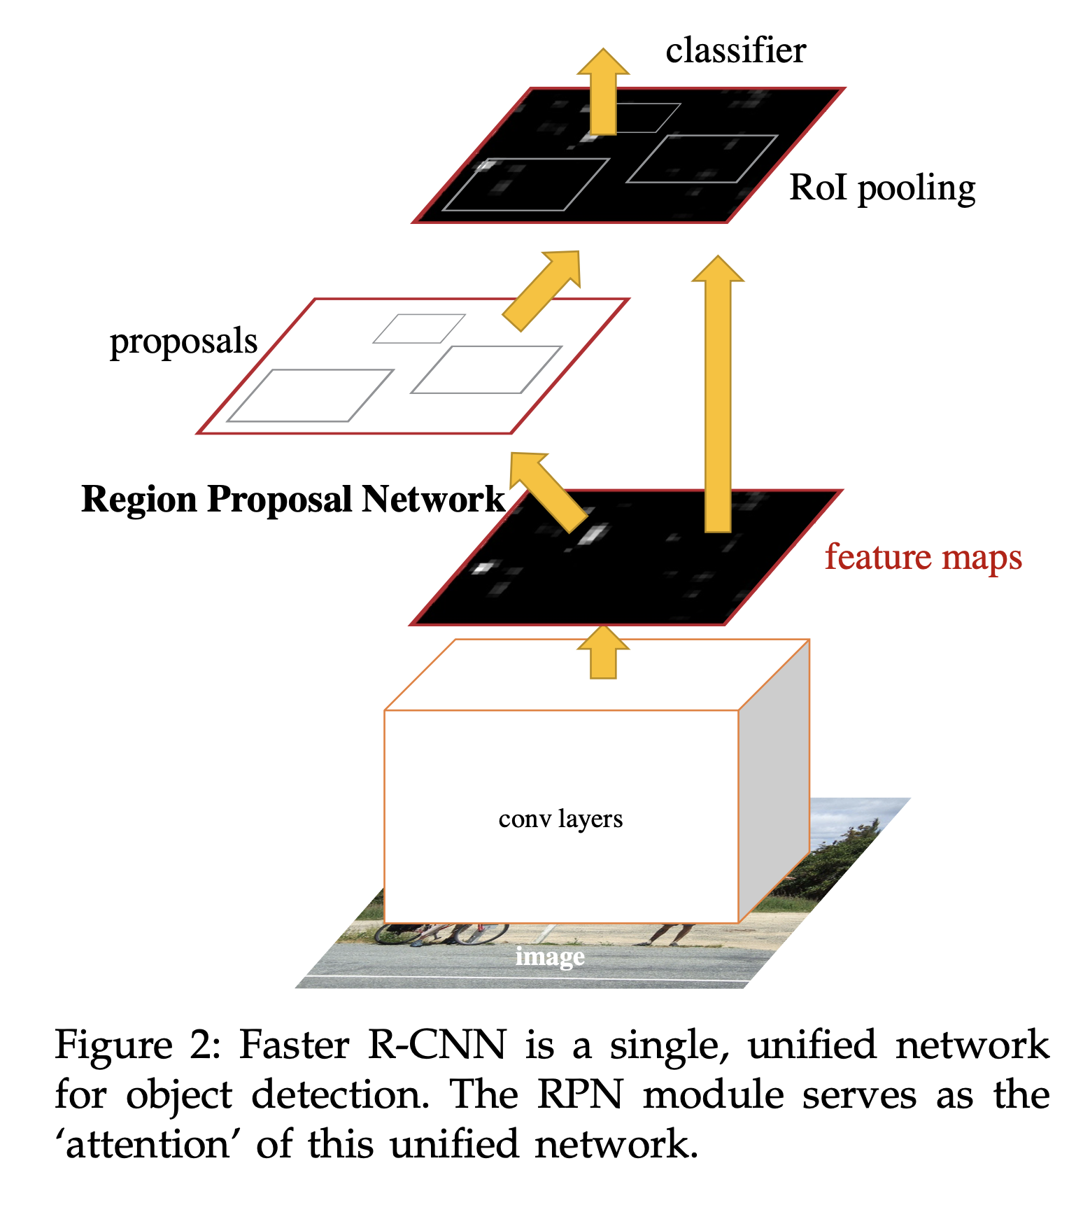
Faster R-CNN - Architecture
The architecture of Faster R-CNN is built around the following components:
Convolutional Backbone: Extracts feature maps from the input image (e.g., VGG-16, ResNet).
Region Proposal Network (RPN):
Slides over the shared feature map.
Proposes object regions using anchor boxes of different scales and aspect ratios.
ROI Pooling Layer:
Extracts fixed-size feature maps from proposals for classification.
Fully Connected Layers:
Classifies each region and regresses bounding box coordinates.
Unified Network:
Shares convolutional features between RPN and detection head for speed and memory efficiency.

Slide 21
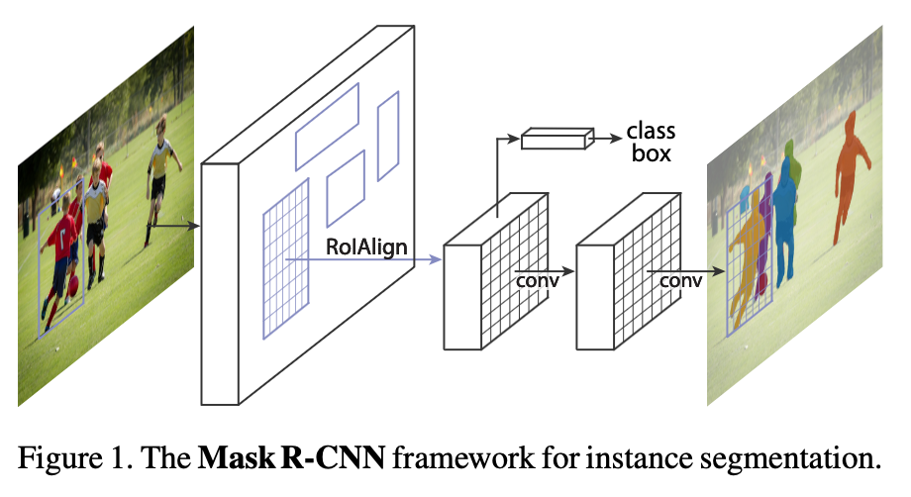
Masked R-CNN
A flexible framework for instance segmentation that extends Faster R-CNN by adding a parallel branch to predict a pixel‐level mask for each detected object .
RoIAlign: Eliminates quantization in RoI pooling via bilinear interpolation, improving mask boundary accuracy by up to 50% .
Decoupled Mask & Class: Predicts one binary mask per class (via per-pixel sigmoid) without competition between classes, while the detection branch handles classification and box regression .

Slide 22
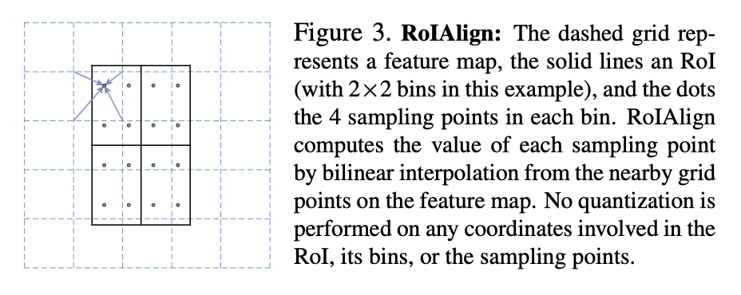
Masked R-CNN Workflow
Backbone + RPN:
Extract multi-scale features using ResNet-C4 or FPN; generate region proposals via RPN sliding over shared feature maps .
RoIAlign:
For each RoI, sample exact feature values at pre-defined points using bilinear interpolation—avoiding any quantization to preserve spatial alignment .
Parallel Heads:
Classification Head: predicts object class.
Box Head: refines bounding-box coordinates.
Mask Head: a small fully convolutional network that outputs an m×m binary mask for each detected object .
Post-Processing:
Apply NMS on boxes; upsample each m×m mask to the original RoI size and threshold at 0.5 to produce final instance masks .

Slide 23
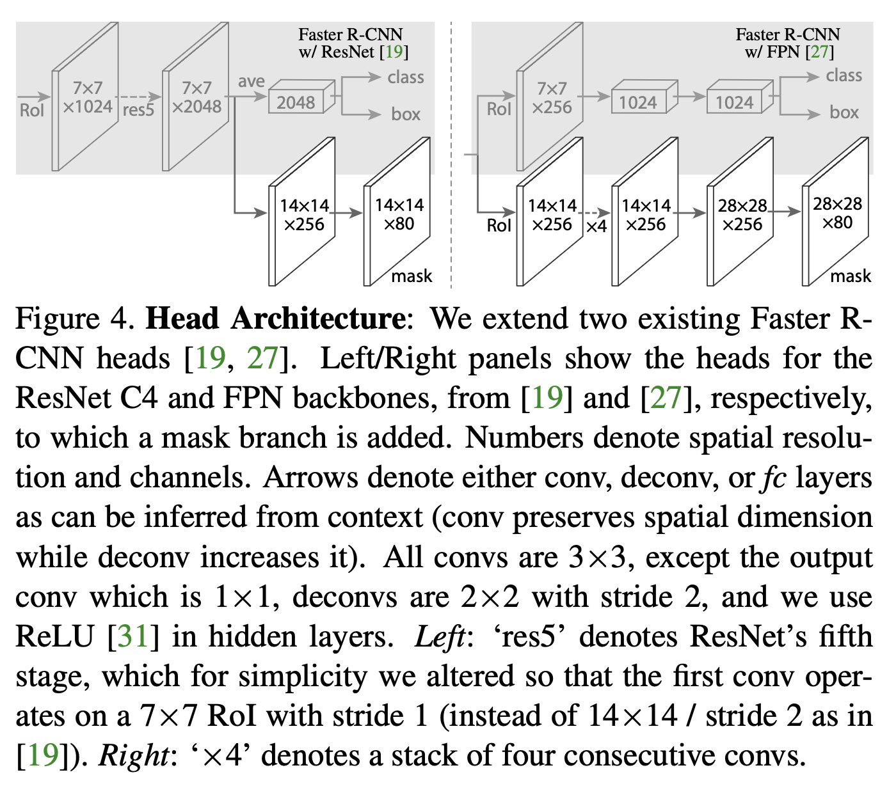
Masked R-CNN Architecture
Backbone Variants:
ResNet-50/101-C4 or ResNet-50/101-FPN (for multi-scale feature fusion) .
Region Proposal Network (RPN):
3×3 conv over feature map → two sibling 1×1 convs for objectness (2k scores) and bbox deltas (4k values) per anchor .
RoIAlign Layer:
Samples features with bilinear interpolation into fixed-size bins (e.g., 7×7 for detection, 14×14 for mask) to feed subsequent heads .
Head Details:
Box & Class Head: for each RoI, uses either the ResNet res5 block (C4 variant) or a 4-conv stack (FPN variant), followed by two FC layers for classification and box regression.
Mask Head: 4×3×3 conv layers → 2×2 deconv (stride 2) → 1×1 conv to produce K masks of resolution 28×28 .
Training Loss:
L = L__{cls} + L__{box} + L__{mask}
where L_{\text{mask}} is the per-pixel binary cross-entropy on the true-class mask only

Slide 24
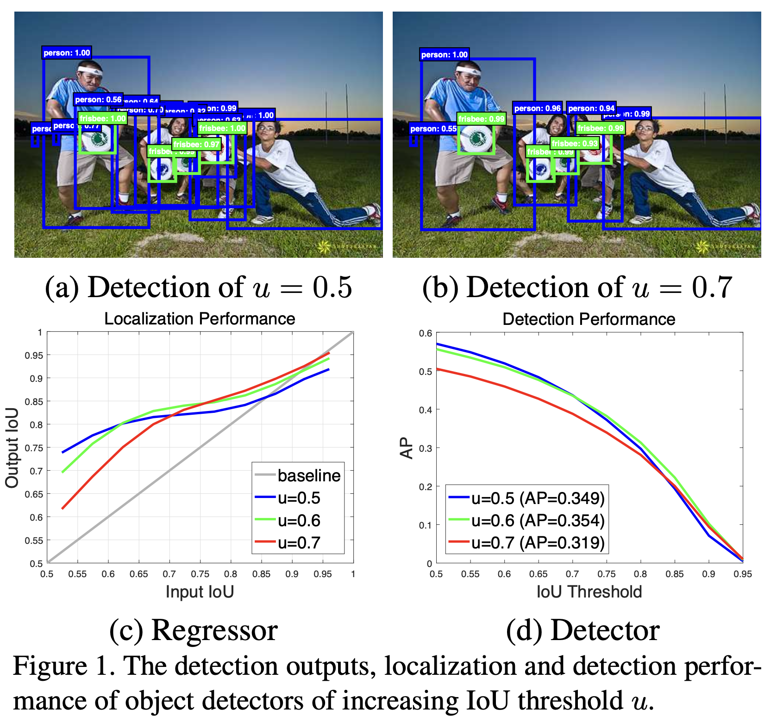
Cascade R-CNN
A multi-stage extension of the two-stage R-CNN framework that trains a sequence of detectors with increasing IoU thresholds to progressively reject close false positives and improve localization quality .
Overfitting at High IoU: Raising the IoU threshold in a single detector leads to too few positives and overfitting.
Quality Mismatch: A detector trained for one IoU level underperforms when evaluated on hypotheses of different quality .
Core Idea:
Train stages for u = 0.5, 0.6, 0.7 in sequence, using each stage’s regressed outputs to resample higher-quality proposals for the next—maintaining ample positives and matching detector quality to proposal quality .
Impact:
Surpasses all single-model detectors on COCO, with consistent AP gains (2–4 pts) over diverse baselines at marginal extra cost

Slide 25
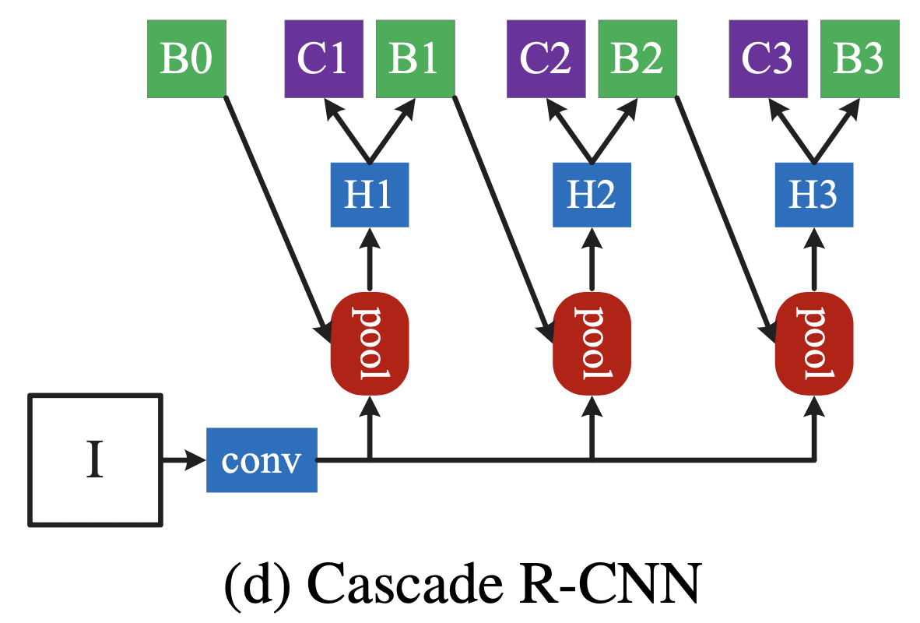
Cascade R-CNN Workflow
Stage 0 – RPN Proposals:
Generate initial object proposals (b₀) via the Region Proposal Network sliding over the shared backbone features .
Stage 1 (u₁ = 0.5):
Train detector head H₁ on (x, b₀), classify and regress to produce refined boxes b₁.
Stage 2 (u₂ = 0.6):
Resample proposals: use b₁ as new hypotheses (x, b₁), train H₂ with IoU threshold 0.6 → outputs b₂.
Stage 3 (u₃ = 0.7):
Repeat on b₂ with threshold 0.7 → final b₃.
Inference:
Apply the same sequence: RPN → H₁ → H₂ → H₃, yielding progressively higher-quality detections.

Slide 26
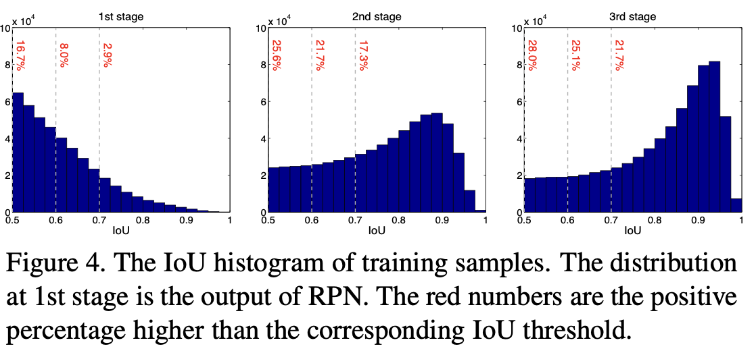
Cascade R-CNN Architecture
Backbone & RPN (Stage 0):
Any CNN backbone (e.g., ResNet-50/101 with FPN); RPN head: 3×3 conv → sibling 1×1 convs for objectness and bbox deltas .
Cascade Heads (Stages 1–3):
Each head t has the same architecture as the baseline detection head:
Box & Class Subnet: RoIAlign → 2 FC layers → softmax (K+1 classes) + 4-D bbox regression.
IoU Thresholds: u₁=0.5, u₂=0.6, u₃=0.7.
Cascaded Regression:
Regression functions f₁, f₂, f₃ composed as
f(x,b) = f₃(x,f₂(x,f₁(x,b)))
Each fₜ optimized on the resampled bₜ₋₁ distribution to avoid overfitting .
Multi-Task Loss per Stage:
Lₜ = L_{cls}(hₜ(x), yₜ) + [yₜ>=1]L_{loc}(fₜ(x,bₜ₋₁), g)
where yₜ labels proposals by IoU≥uₜ; enables joint classification and regression with balanced positive samples .

Slide 27
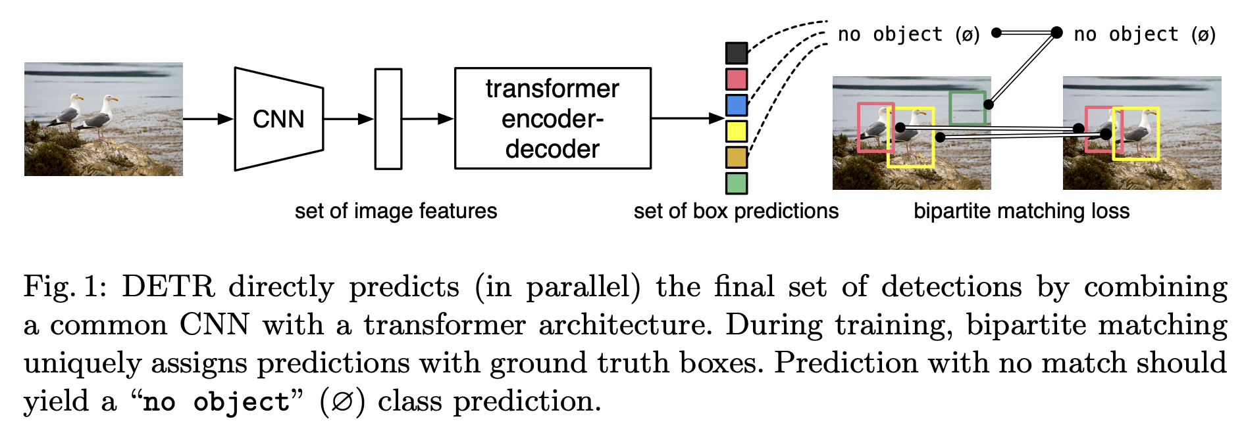
Transformer-Based Detection Models
DETR (DEtection TRansformer)
DETR (DEtection TRansformer) is a novel object detection model that applies the transformer architecture, commonly used in natural language processing, directly to object detection. Unlike traditional detectors that rely on hand-crafted components like anchor boxes and non-maximum suppression, DETR simplifies detection by formulating it as a direct set prediction problem.
Key points:
First fully end-to-end object detector using transformers.
Eliminates the need for region proposal networks and post-processing steps.
Achieves competitive accuracy with a streamlined, unified pipeline.

Slide 28
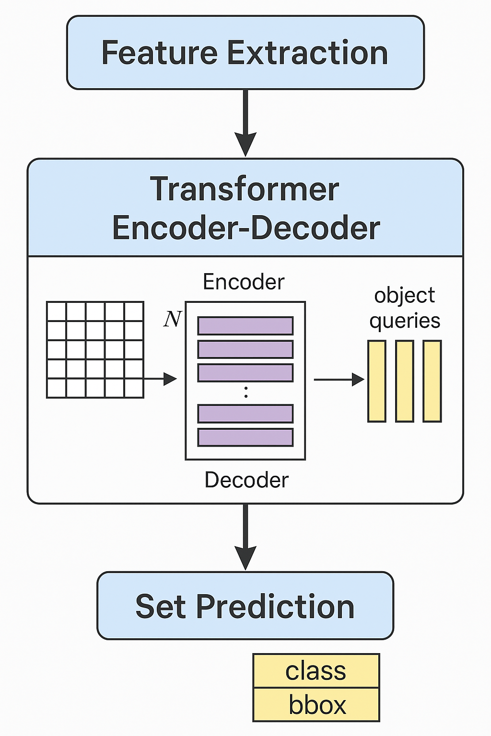
DETR Workflow
DETR processes an image through the following workflow:
Feature Extraction: An input image is passed through a convolutional backbone (like ResNet) to generate a compact feature map.
Transformer Encoder-Decoder: The feature map is flattened and passed into a transformer encoder, which models global context. The transformer decoder receives a fixed number of learned object queries and predicts bounding boxes and class labels for each query.
Set Prediction: DETR outputs a fixed-size set of predictions. During training, Hungarian matching is used to optimally match predictions to ground truth objects.

Slide 29
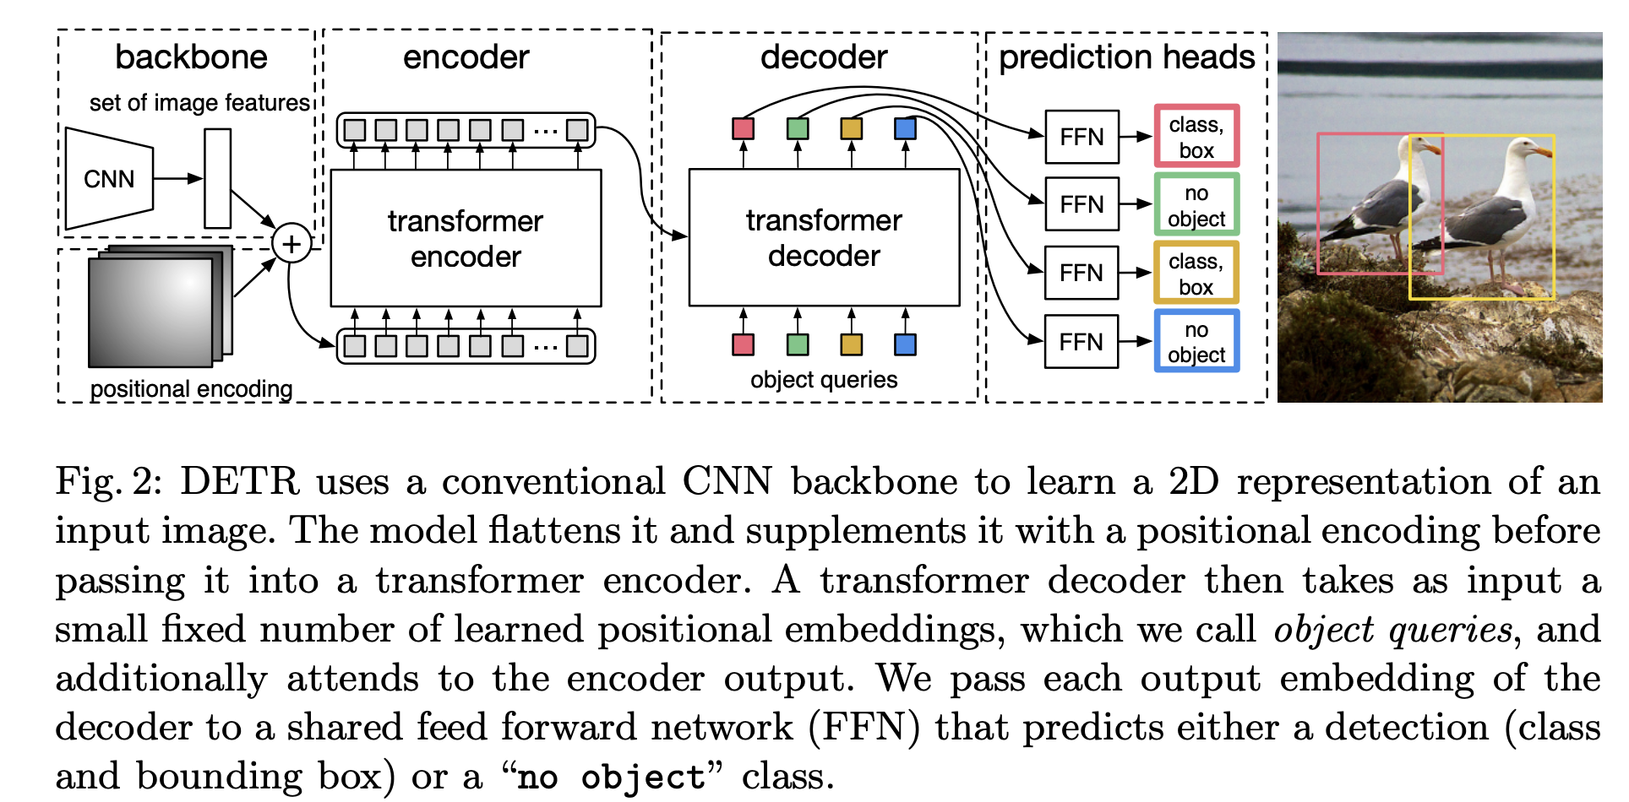
DETR - Architecture
DETR architecture includes:
CNN Backbone: Extracts dense feature maps from the input image.
Transformer Encoder: Processes the feature map, attending globally to all image locations.
Transformer Decoder: Receives learned object queries, decodes them into object representations.
Prediction Heads: Each query is passed through feed-forward layers to produce a class label and bounding box coordinates.
End-to-End Loss: The model is trained with a bipartite matching loss, allowing direct supervision without NMS or anchors.

Slide 30
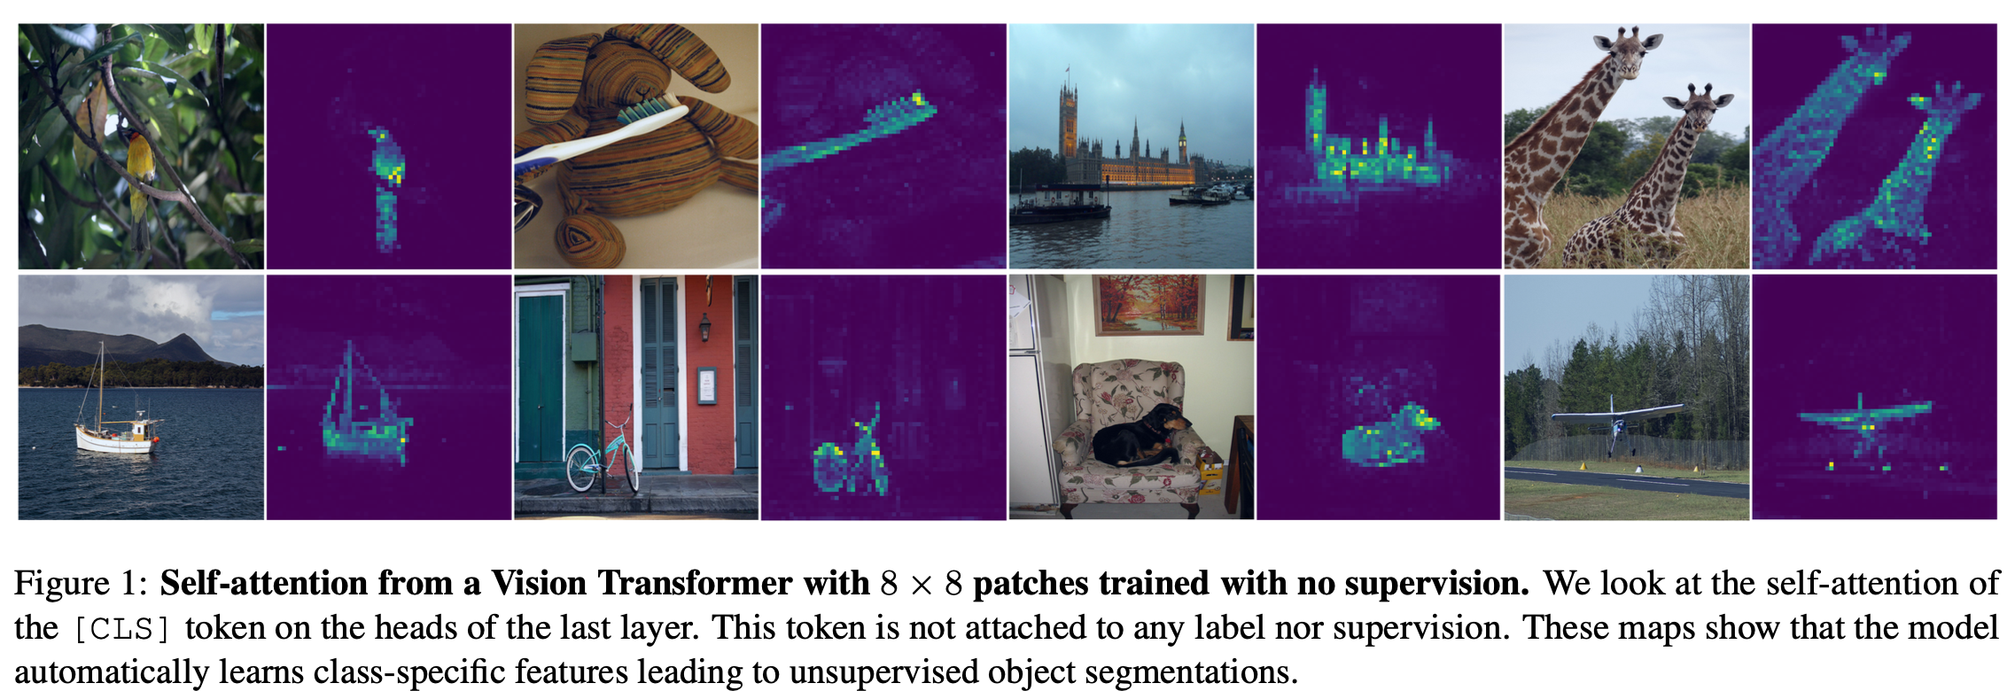
DINO (Self-Distillation with No Labels)
DINO (Self-Distillation with No Labels) is a self-supervised learning method designed for Vision Transformers (ViTs) and convolutional networks. DINO enables models to learn rich, transferable features without any labeled data, and leads to unique properties—such as automatically discovering object boundaries and scene layout from images.
Key points:
Learns high-quality visual representations without supervision.
Achieves strong performance in classification, retrieval, and segmentation.
Especially effective with Vision Transformers (ViTs), unlocking emergent properties not seen in supervised training.

Slide 31
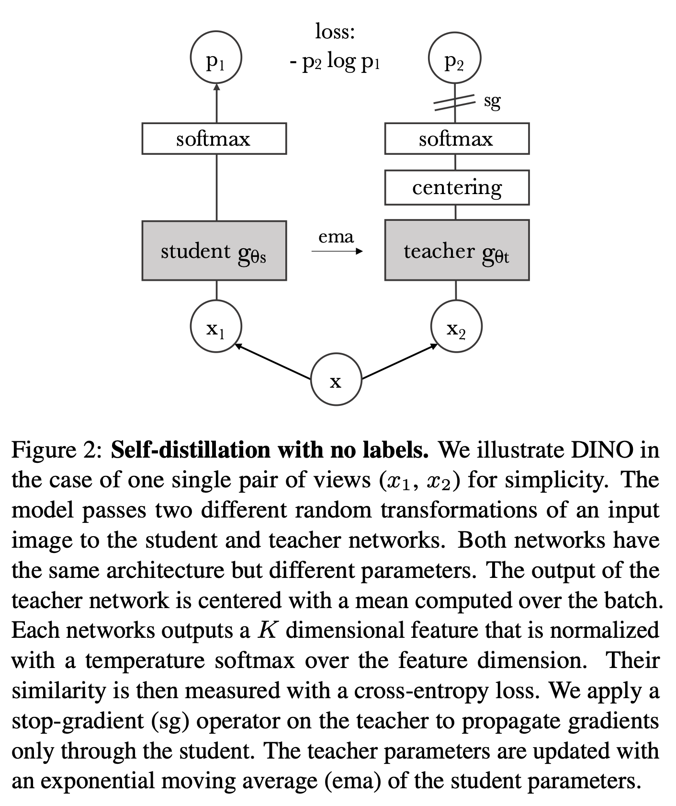
DINO -Workflow
The DINO workflow is based on a self-distillation framework with no labels:
An input image is transformed into multiple different crops (global and local views).
Each view is passed through two networks: a student and a teacher (both with the same architecture).
The teacher is updated as an exponential moving average of the student (momentum encoder).
The student is trained to match the teacher’s output (using a cross-entropy loss), with no labels involved.
This process uses centering and sharpening to avoid collapse (trivial solutions).

Slide 32
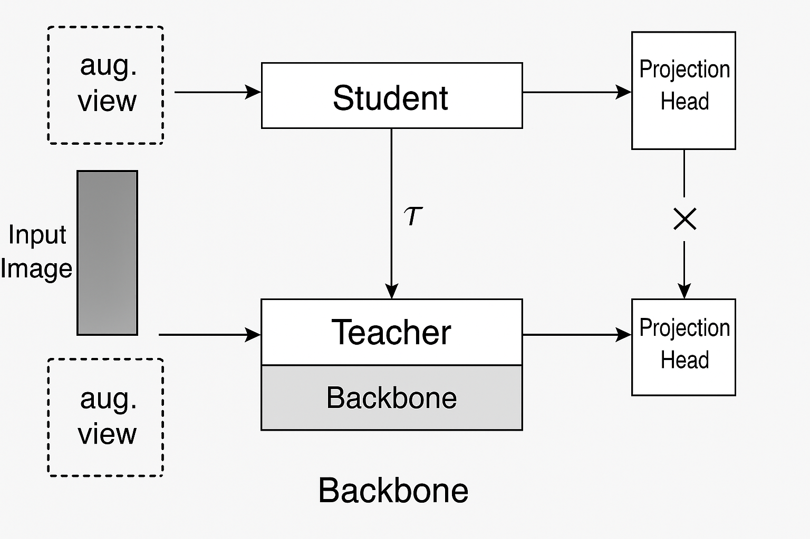
DINO - Architecture
DINO’s architecture is flexible and can be applied to ViTs or CNNs.
Backbone: Can be a Vision Transformer (ViT) or ResNet.
Projection Head: Multilayer perceptron (MLP) on top of the backbone to produce embedding features.
Student & Teacher: Identical architectures, but the teacher is updated via momentum (not gradients).
Input Augmentations: Multi-crop strategy (two global crops and several local crops).
Output: Student and teacher produce normalized feature vectors, and the student is trained to match the teacher.

Slide 33
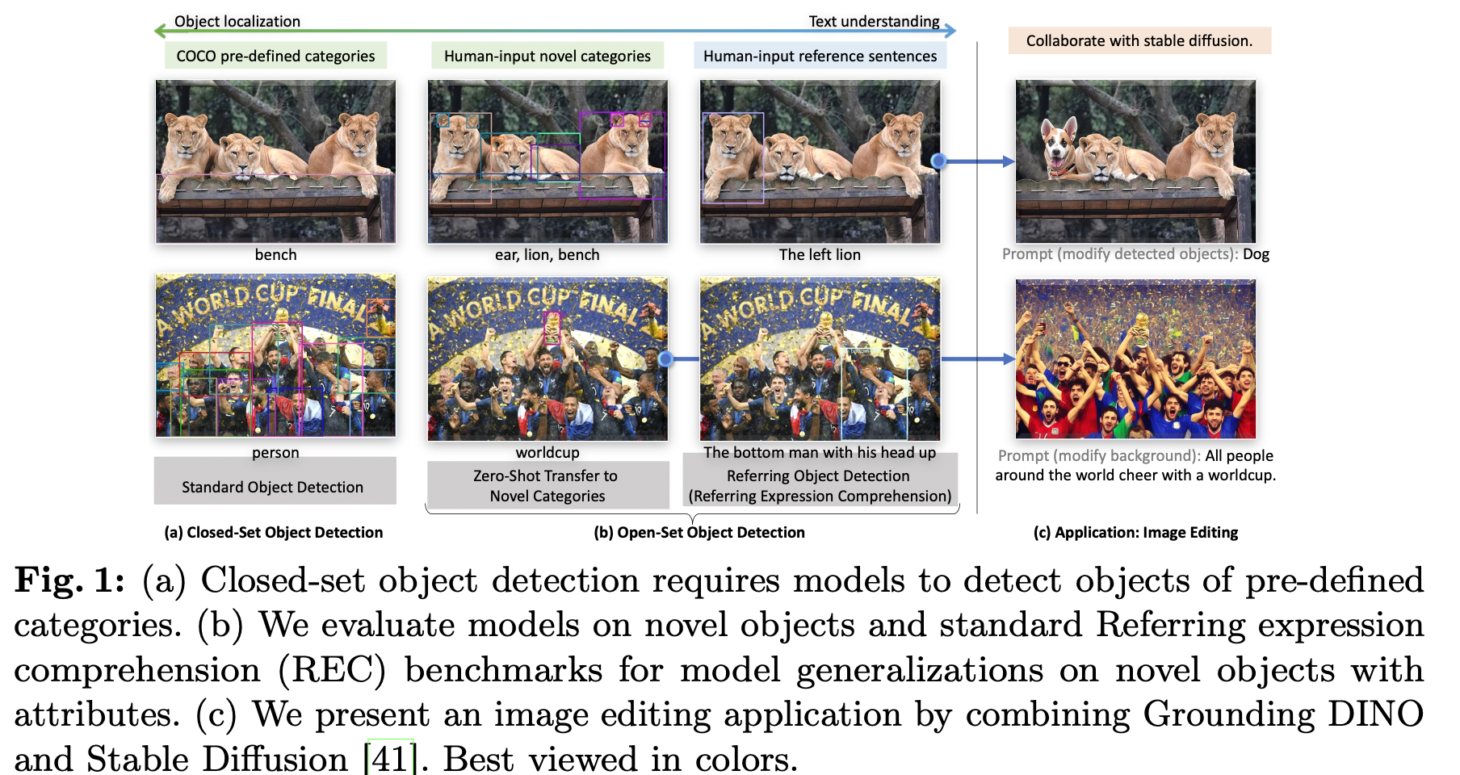
Grounding DINO
An open-set object detector that marries the end-to-end DETR-based DINO architecture with grounded pre-training to detect arbitrary objects specified via language inputs (category names or referring expressions) .
Key Principles:
Tight Modality Fusion: integrates vision and language across three phases—neck (feature enhancer), query initialization, and decoder—to learn language-aware region embeddings .
Large-Scale Grounded Pre-Training: uses a mixture of detection, grounding (phrase-to-region), and caption data to generalize to novel categories without fine-tuning .

Slide 34
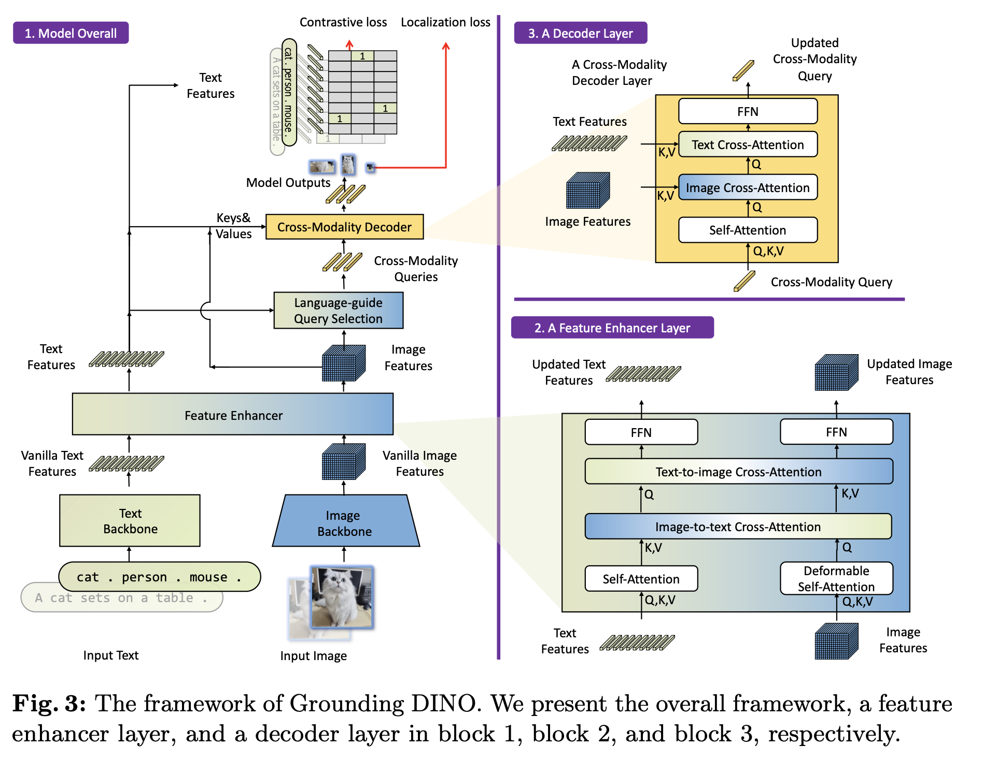
Grounding DINO - Workflow
Feature Extraction:
Image Backbone (e.g., Swin Transformer) → multi-scale image tokens.
Text Backbone (e.g., BERT) → token embeddings for input prompt.
Feature Enhancer (Neck):
Stack of layers combining self-attention, image→text and text→image cross-attention, plus deformable self-attention to fuse modalities .
Language-Guided Query Selection:
Compute similarity between image tokens and text features; select top N_{q} image tokens as cross-modality queries for the decoder .
Cross-Modality Decoder:
Each decoder layer applies: self-attention → image cross-attention → text cross-attention → FFN, refining queries to capture joint semantics .
Prediction:
Final queries predict bounding boxes (via box regression head) and ground to text spans (via contrastive classification loss).

Slide 35
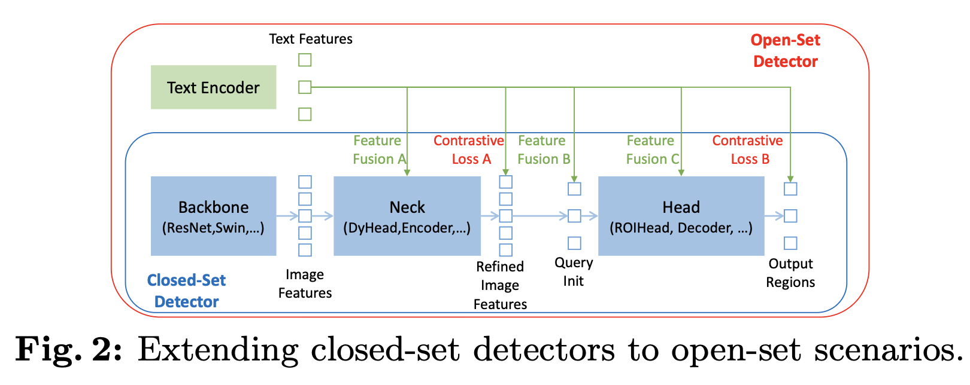
Grounding DINO - Architecture
Language-Guided Query Selection:
Select top N_{q}=900 image tokens via TopN_{q}(max_{t}(X_{I}, X_{T})) to initialize decoder queries .
Cross-Modality Decoder:
D layers of:
Self-Attention → Image Cross-Attention → Text Cross-Attention → FFN
Final queries feed into heads for box regression (L1 + GIoU loss) and text contrastive classification (focal loss) .
Training Loss:
L = L_{loc}^{(L1+GIoU)} + L_{cls}^{contrastive}
with auxiliary losses after each decoder layer.
Dual-Encoder–Single-Decoder Design:
Image Encoder (Swin-T/L): produces multi-scale feature maps.
Text Encoder (BERT): yields sub-sentence level embeddings to avoid cross-category interference .
Feature Enhancer Module:
L layers of:
Deformable Self-Attention on image features
Image→Text Cross-Attention
Text→Image Cross-Attention
FFNdecoder layer.

Slide 36
Vision–Language (Multi-Modal) Models
CLIP (Contrastive Language–Image Pre-training)
CLIP (Contrastive Language–Image Pre-training) is a vision-language model that learns to connect images and natural language through contrastive learning on a massive dataset of image–text pairs. Unlike traditional computer vision models that require labeled datasets and task-specific fine-tuning, CLIP can recognize and classify visual concepts using just a text description—enabling powerful zero-shot learning across many domains.
Key Points:
Trained on 400 million (image, text) pairs from the internet.
Can perform a wide variety of visual classification tasks without task-specific training.
Enables zero-shot transfer: the model can classify new concepts just by providing their text descriptions.

Slide 37
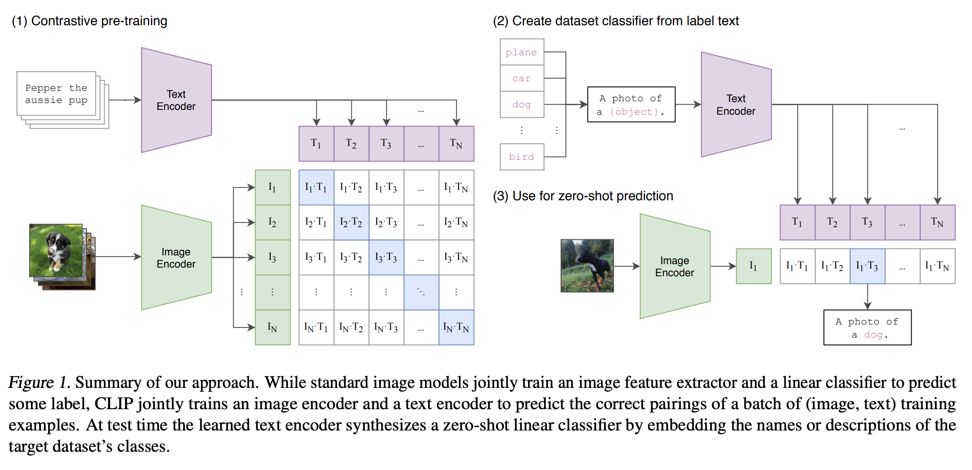
CLIP - Workflow
The CLIP workflow consists of three main steps:
Contrastive Pre-Training:
The model is jointly trained to match images and their paired text descriptions in a shared embedding space.
Two separate encoders (for images and text) are trained with a contrastive loss to bring paired image–text embeddings close, and push non-matching pairs apart.
2. Zero-Shot Classification:
To classify an image, CLIP computes similarities between the image embedding and a set of candidate text embeddings (e.g., “a photo of a cat,” “a photo of a dog,” etc.).
The class with the highest similarity is chosen as the prediction.
3. Generalization:
The model’s text interface allows it to adapt to new tasks or classes simply by providing appropriate prompts—no additional training is required.

Slide 38
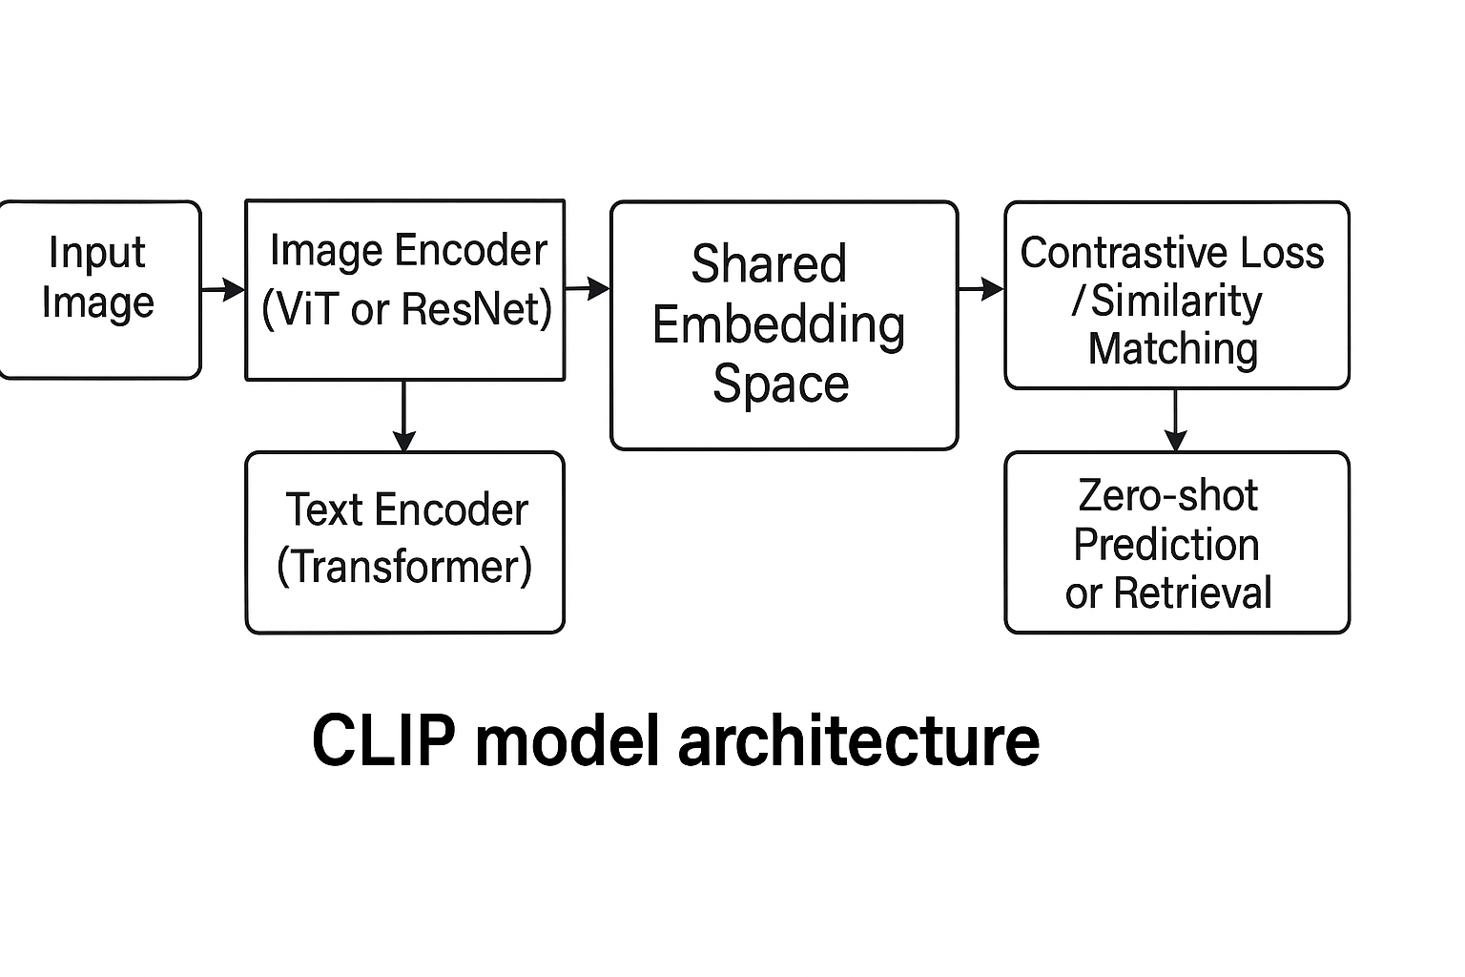
CLIP - Architecture
CLIP uses a dual-encoder architecture:
Image Encoder:
Can be a Vision Transformer (ViT) or ResNet; maps images to feature vectors.
Text Encoder:
A Transformer-based network that maps tokenized text to feature vectors.
Shared Embedding Space:
Both encoders are trained so that matching image–text pairs are close in this space.
Contrastive Loss:
Ensures that only the correct image–text pairs are aligned.
Scalability:
Trained on web-scale data (400M pairs), the architecture generalizes well to many downstream vision tasks.

Slide 39
References
YOLO (You Only Look Once)
Redmon, J., Divvala, S., Girshick, R., & Farhadi, A.
You Only Look Once: Unified, Real-Time Object Detection
arXiv:1506.02640
EfficientDet
Tan, M., Pang, R., & Le, Q. V.
EfficientDet: Scalable and Efficient Object Detection
arXiv:1911.09070
SSD (Single Shot MultiBox Detector)
Liu, W., Anguelov, D., Erhan, D., Szegedy, C., Reed,
S., Fu, C. Y., & Berg, A. C.
SSD: Single Shot MultiBox Detector
arXiv:1512.02325
RetinaNet
Lin, T.-Y., Goyal, P., Girshick, R., He, K., & Dollár, P.
Focal Loss for Dense Object Detection
arXiv:1708.02002
Faster R-CNN
Ren, S., He, K., Girshick, R., & Sun, J.
Faster R-CNN: Towards Real-Time Object Detection with Region Proposal Networks
arXiv:1506.01497

Slide 40
References
Mask R-CNN (Mask Region-based Convolutional Neural Network)
He, K., Gkioxari, G., Dollár, P., & Girshick, R.
Mask R-CNN
https://arxiv.org/abs/1703.06870
Cascade R-CNN: Delving into High Quality Object Detection
Cai, Z., & Vasconcelos, N.
https://arxiv.org/abs/1712.00726
Grounding DINO (Grounded Detection with DINO)
Liu, S., Zeng, Z., Ren, T., Li, F., Zhang, H., Yang, J., Jiang, Q., Li, C., Yang, J., Su, H., Zhu, J., & Zhang, L.
Grounding DINO: Marrying DINO with Grounded Pre-Training for Open-Set Object Detection
https://arxiv.org/abs/2303.05499
DETR (DEtection TRansformer)
Carion, N., Massa, F., Synnaeve, G., Usunier, N., Kirillov, A., & Zagoruyko, S.
End-to-End Object Detection with Transformers
arXiv:2005.12872
DINO (Self-Distillation with No Labels)
Caron, M., Touvron, H., Misra, I., Jégou, H., Mairal, J., Bojanowski, P., & Joulin, A.
Emerging Properties in Self-Supervised Vision Transformers
arXiv:2104.14294
CLIP (Contrastive Language-Image Pre-training)
Radford, A., Kim, J. W., Hallacy, C., Ramesh, A., Goh, G., Agarwal, S., … & Sutskever, I.
Learning Transferable Visual Models From Natural Language Supervision
arXiv:2103.00020

Slide 41
Thank You

